Slide 1

DEPARTMENT OF ARTIFICIAL INTELLIGENCE AND DATA SCIENCE
Vision
To impart international quality education, promote collaborative research and graduate industry-ready engineers in the domain of Artificial Intelligence and Data Science to serve the society.

Slide 2
Inheritance
Inheritance
Inheritance is definning a new class from existing class in which inherits all the methods and properties from another class.
Parent class or base class is the class being inherited from another class.
Child class or derived class is the class that inherits from another class.

Slide 3
Inheritance Ex2
class Person: # parent class
def __init__(self, fname, lname):
self.firstname = fname
self.lastname = lname
def printname(self):
print(self.firstname, self.lastname)
class Student(Person): # child class
pass
x = Student(“Ajith", “Kumar")
x.printname()

Slide 4
Inheritance Ex2
class Person: # parent class
def __init__(self, fname, lname):
self.firstname = fname
self.lastname = lname
def printname(self):
print(self.firstname, self.lastname)
class Student(Person): # child class or derived class
def __init__(self, fname, lname):
super().__init__(fname, lname)
self.graduationyear = 2019 #child class property or data
x = Student(“Ajith", “kumar")
x.print()
print(x.graduationyear)

Slide 5
class CreditCard:
"""A consumer credit card."""
def __init__(self, customer, bank, acnt, limit):
self._customer = customer
self._bank = bank
self._account = acnt
self._limit = limit
self._balance = 0

Slide 6
def get_customer(self):
"""Return name of the customer."""
return self._customer
def get_bank(self):
"""Return the bank's name."""
return self._bank
def get_account(self):
"""Return the card identifying number (typically stored as a string)."""
return self._account
def get_limit(self):
"""Return current credit limit."""
return self._limit
def get_balance(self):
"""Return current balance."""
return self._balance

Slide 7
def charge(self, price):
"""Charge given price to the card, assuming sufficient credit limit.
Return True if charge was processed; False if charge was denied.
"""
if price + self._balance > self._limit: # if charge would exceed limit,
return False # cannot accept charge
else:
self._balance += price
return True
def make_payment(self, amount):
"""Process customer payment that reduces balance."""
self._balance -= amount

Slide 8
if __name__ == '__main__':
wallet = []
wallet.append(CreditCard('John Bowman', 'California Savings',
'5391 0375 9387 5309', 2500) )
wallet.append(CreditCard('John Bowman', 'California Federal',
'3485 0399 3395 1954', 3500) )
wallet.append(CreditCard('John Bowman', 'California Finance',
'5391 0375 9387 5309', 5000) )
for val in range(1, 17):
wallet[0].charge(val)
wallet[1].charge(2*val)
wallet[2].charge(3*val)

Slide 9
for c in range(3):
print('Customer =', wallet[c].get_customer())
print('Bank =', wallet[c].get_bank())
print('Account =', wallet[c].get_account())
print('Limit =', wallet[c].get_limit())
print('Balance =', wallet[c].get_balance())
while wallet[c].get_balance() > 100:
wallet[c].make_payment(100)
print('New balance =', wallet[c].get_balance())
print()

Slide 10
class PredatoryCreditCard(CreditCard): # inheritance
"""An extension to CreditCard that compounds interest and fees."""
def __init__(self, customer, bank, acnt, limit, apr):
"""Create a new predatory credit card instance.
apr annual percentage rate (e.g., 0.0825 for 8.25% APR) """
super().__init__(customer, bank, acnt, limit) # call super constructor
self._apr = apr
def charge(self, price):
"""Charge given price to the card, assuming sufficient credit limit.
Return True if charge was processed.
Return False and assess $5 fee if charge is denied. """
success = super().charge(price) # call inherited method
if not success:
self._balance += 5 # assess penalty
return success # caller expects return value

Slide 11
def process_month(self):
"""Assess monthly interest on outstanding balance."""
if self._balance > 0:
# if positive balance, convert APR to monthly multiplicative factor (e.g., 0.0825 for 8.25% APR)
monthly_factor = pow(1 + self._apr, 1/12)
self._balance *= monthly_factor

Slide 12
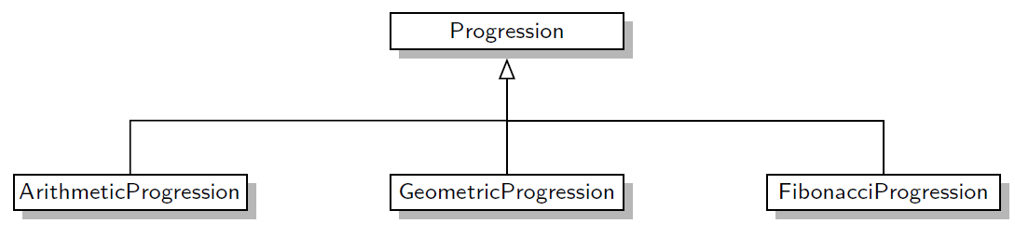
Inheritance: Numeric Progressions
Default progression: 0 1 2 3 4 5 6 7 8 9
Arithmetic progression with increment 5:
0 5 10 15 20 25 30 35 40 45
Arithmetic progression with increment 5 and start 2:
2 7 12 17 22 27 32 37 42 47
Geometric progression with default base:
1 2 4 8 16 32 64 128 256 512
Geometric progression with base 3:
1 3 9 27 81 243 729 2187 6561 19683
Fibonacci progression with default start values:
0 1 1 2 3 5 8 13 21 34
Fibonacci progression with start values 4 and 6:
4 6 10 16 26 42 68 110 178 288

Slide 13
Abstract class
abstract base class
A class which contains one or more abstract methods is called an abstract class. An abstract method is a method that has a declaration but does not have an implementation
An abstract base class is one that cannot be directly instantiated, while a concrete class is one that can be instantiated.
In python, the collections.Sequence abstract base class defines functions common to Python’s list, str, and tuple classes, as sequences that support element access via an integer index.

Slide 14

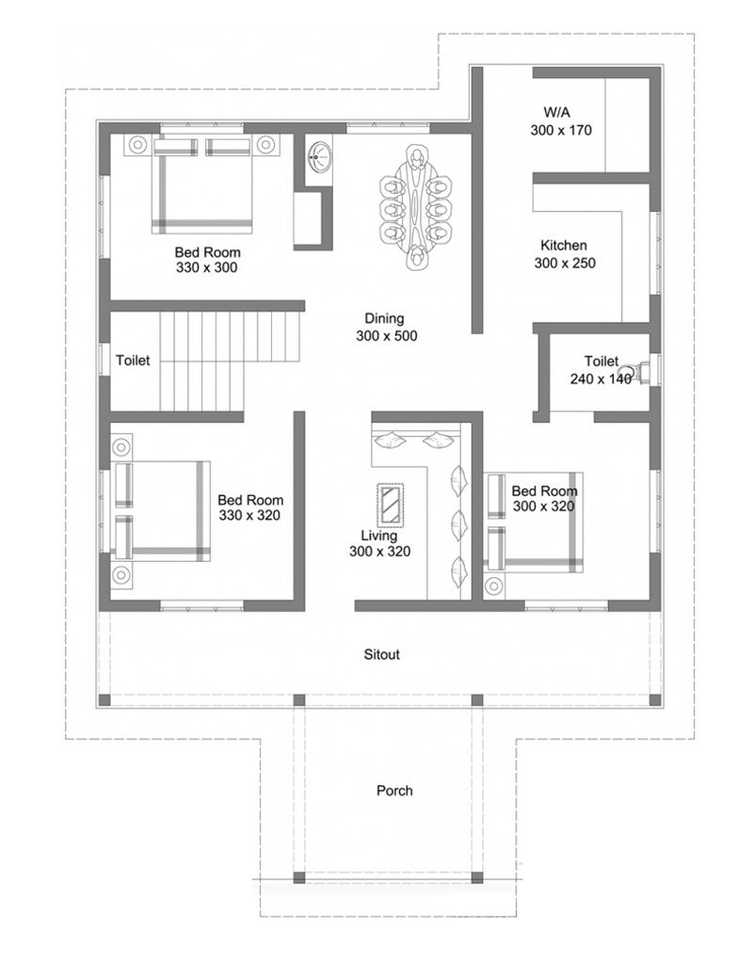


Slide 15
Python comes with a module called ABC that defining Abstract Base classes(ABC).
ABC decorates methods of the base class as abstract and then registering concrete classes as implementations of the abstract base.
from abc import ABC, abstractmethod
class Polygon(ABC): # abstract class
@abstractmethod
def noofsides(self):
pass
class Triangle(Polygon):
# overriding abstract method
def noofsides(self):
print("I have 3 sides")
class Pentagon(Polygon):
# overriding abstract method
def noofsides(self):
print("I have 5 sides")

Slide 16
class Hexagon(Polygon):
# overriding abstract method
def noofsides(self):
print("I have 6 sides")
class Quadrilateral(Polygon):
# overriding abstract method
def noofsides(self):
print("I have 4 sides")
R = Triangle()
R.noofsides()
K = Quadrilateral()
K.noofsides()
R = Pentagon()
R.noofsides()
K = Hexagon()
K.noofsides()

Slide 17
Polymorphism: Method Overriding or runtime polymorphism
The parent class and child class having the same method. This process of re-implementing a method in the child class is known as Method Overriding
class Bird:
def intro(self):
print("There are many types of birds.")
def flight(self):
print("Most of the birds can fly but some cannot.")
class sparrow(Bird): # child class
def flight(self):
print("Sparrows can fly.")
class ostrich(Bird): # child class
def flight(self):
print("Ostriches cannot fly.")

Slide 18
Polymorphism: Method Overriding or runtime polymorphism
obj_bird = Bird()
obj_spr = sparrow()
obj_ost = ostrich()
obj_bird.intro()
obj_bird.flight()
obj_spr.intro()
obj_spr.flight()
obj_ost.intro()
obj_ost.flight()

Slide 19
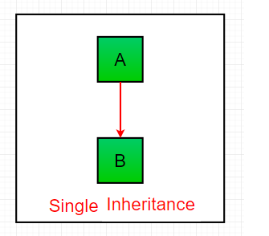
Types of Inheritance
Single inheritance
Single inheritance enables a derived class to inherit properties from a single parent class
# Base class
class Parent:
def func1(self):
print("This function is in parent class.")
# Derived class
class Child (Parent):
def func2(self):
print("This function is in child class.")
# Driver's code
object = Child()
object.func1()
object.func2()
Parent
Child

Slide 20
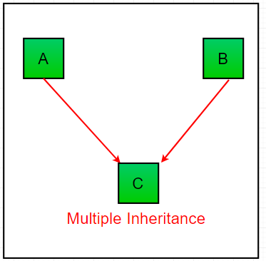
Types of Inheritance
Multiple Inheritance
When a class can be derived from more than one base class this type of inheritance is called multiple inheritance. In multiple inheritance, all the features of the base classes are inherited into the derived class.
Mother
Father
Son

Slide 21
class Mother: # Base class1
mothername = ""
def mother(self):
print(self.mothername)
class Father: # Base class2
fathername = ""
def father(self):
print(self.fathername)
# Derived class
class Son(Mother, Father):
def parents(self):
print("Father :", self.fathername)
print("Mother :", self.mothername)
# Driver's code
s1 = Son()
s1.fathername = "RAM"
s1.mothername = "SITA"
s1.parents()

Slide 22
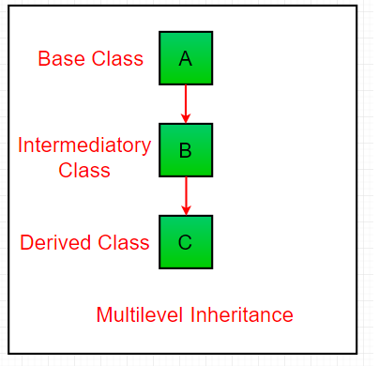
Multilevel Inheritance In multilevel inheritance, features of the base class and the derived class are further inherited into the new derived class. This is similar to a relationship representing a child and grandfather
Grandfather
father
son

Slide 23
class Grandfather: # Base class
def __init__(self, grandfathername):
self.grandfathername = grandfathername
class Father(Grandfather): # Derived class
def __init__(self, fathername, grandfathername):
self.fathername = fathername
# invoking constructor of Grandfather class
Grandfather.__init__(self, grandfathername)
class Son(Father): # Derived class
def __init__(self,sonname, fathername, grandfathername):
self.sonname = sonname
# invoking constructor of Father class
Father.__init__(self, fathername, grandfathername)
def print_name(self):
print('Grandfather name :', self.grandfathername)
print("Father name :", self.fathername)
print("Son name :", self.sonname)
s1 = Son('Prince', 'Rampal', 'Lal mani')
print(s1.grandfathername)
s1.print_name()

Slide 24
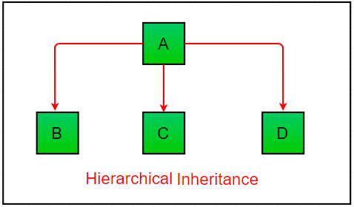
Hierarchical Inheritance:
When more than one derived classes are created from a single base this type of inheritance is called hierarchical inheritance.
Parent
Child1
Child2
Child3

Slide 25
# Base class
class Parent:
def func1(self):
print("This function is in parent class.")
# Derived class1
class Child1(Parent):
def func2(self):
print("This function is in child 1.")
# Derivied class2
class Child2(Parent):
def func3(self):
print("This function is in child 2.")
# Driver's code
object1 = Child1()
object2 = Child2()
object1.func1()
object1.func2()
object2.func1()
object2.func3()

Slide 26
Hybrid Inheritance:
Inheritance consisting of multiple types of inheritance is called hybrid inheritance.
class School:
def func1(self):
print("This function is in school.")
class Student1(School):
def func2(self):
print("This function is in student 1. ")
class Student2(School):
def func3(self):
print("This function is in student 2.")
class Student3(Student1, School):
def func4(self):
print("This function is in student 3.")
# Driver's code
object = Student3()
object.func1()
object.func2()
school
Hierarchical Inheritance
Student2
Student1
Multiple
Inheritance
Student3

Slide 27
Nested class
Class defined within a class is called Nested class
# create a Color class
class Color:
def __init__(self):
# object attributes
self.name = 'Green'
self.lg = self.Lightgreen() # Class defined in color class
def show(self):
print("Name:", self.name)
# create Lightgreen class
class Lightgreen:
def __init__(self):
self.name = 'Light Green'
self.code = '024avc'
def display(self):
print("Name:", self.name)
print("Code:", self.code)

Slide 28
# create Color class object
outer = Color()
# method calling
outer.show()
# create a Lightgreen
# inner class object
g = outer.lg
# inner class method calling
g.display()

Slide 29
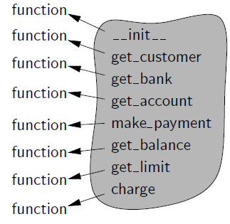
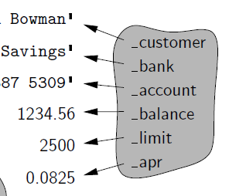
A namespace is an abstraction that manages all of the identifiers that are defined in a particular scope, mapping each name to its associated value
instance namespace, which manages attributes specific to an individual object
Class namespace is used to manage members that are to be shared by all instances of a class.
instance namespace
Class namespace

Slide 30
References
https://www.geeksforgeeks.org/python-oops-concepts/
Michael T. Goodrich , Roberto Tamassia , Michael H. Goldwasser, Data Structures and Algorithms in Python,Wiley publication

